Slide 1


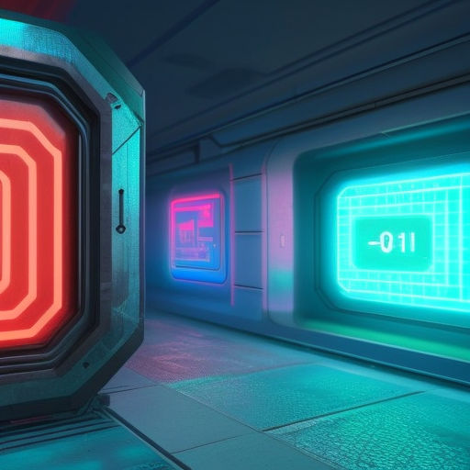
Software Engineering
WEEK 5
ENGR. Muhammad UMER HAROON

Slide 2

WEEK 5

Slide 3
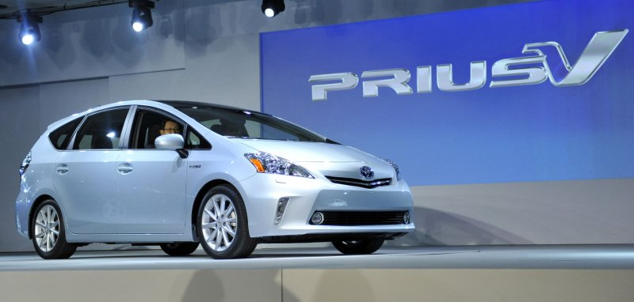
Lean Software Development
Lean Software Development is the application of the principles of the Toyota Product Development System to software development.
Toyota has been extremely successful developing complex new vehicles, which include a vast amount of embedded software, in a very short time and always on time.

Slide 4

A modern car is pretty much a computer on wheels! In a hybrid car about half of the development cost is software, it contains millions of lines of code as all the different subsystems have to integrate with each other. He mentioned that a Lexus contains 14 million lines of code, comparable to banking and airplane software systems.

Slide 5
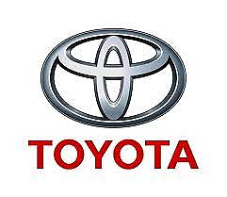
"Lean Software Development: Lean development is based on the principles of lean manufacturing, which originated in the Toyota Production System. The goal of lean development is to create value for the customer by minimizing waste and maximizing flow.
Lean development is focused on delivering the highest value features to the customer as quickly as possible. This is achieved by eliminating waste, reducing cycle time, and continuously improving the development process. Lean development also emphasizes the importance of customer feedback, as it enables the team to prioritize features and adjust the development process based on the customer's needs.
Some specific techniques used in lean development include Kanban, which is a visual workflow management tool that enables the team to visualize the work in progress and identify bottlenecks, and value stream mapping, which is a technique for identifying waste and inefficiencies in the development process.
Overall, lean development is a customer-centric approach that emphasizes collaboration, communication, and continuous improvement. By focusing on value and flow, and by eliminating waste, the team can deliver high-quality software to the customer more quickly and with fewer resources."

Slide 6


Waste is defined as anything that does not add value to the customer, such as defects, overproduction, waiting, excess inventory, unnecessary motion, and overprocessing.
Flow refers to the smooth and uninterrupted flow of work through the development process.

Slide 7
“Lean isn’t something you do,” . “It is a way of thinking.”
The simple part of the lean philosophy is the waste. If you have technical staff sitting around, doing nothing, waiting for a build, that is waste. If they are waiting to set up a server, or need training to complete a task, that is also waste. Excess work in progress inventory is waste.

Slide 8
In some ways, waste is in the eye of the beholder. Metrics, measures, estimates, audits, plans and process may all add visibility to upper management—or keep the auditor happy—but the technical team itself may see no benefit at all from the practices.
Under lean software development, your team defines waste in its own terms. If the government, management or a customer requires something that the team decides does not add value, then you do the absolute minimum to satisfy the requirement. After all, anything beyond that would be waste, right?

Slide 9

7 Lean Principles
○ Eliminate Waste
○ Build Quality
○Create Knowledge
○ Defer commitment
○ Deliver fast
○ Respect people
○ Optimize the Whole

Slide 10
Lean History (I)
Lean is a translation of Lean manufacturing and IT practices into the software development domain
Lean manufacturing itself is derived from the Toyota Production System (TPS)
The term "Lean Software Development" comes from the book "Lean Software Development: An Agile Toolkit" written by Tom & Mary Poppendieck in 2003
The book lays out 7 Principles and 22 Tools that encapsulate the Lean process

Slide 11
Lean History (II)
The fundamental Lean principle is Eliminate Waste
According to the father of the TPS, Taiichi Ohno, waste is defined as anything that does not produce value for the customer
Designs and prototypes are not useful to the customer; they are only valuable when the new product is delivered

Slide 12
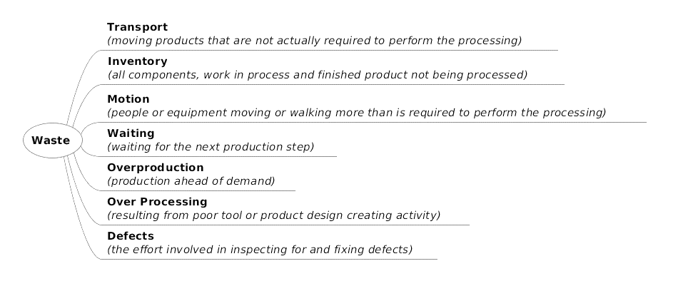
Eliminate Waste (I)
Tool #1: Seeing Waste
Agile practices seek to eliminate waste, but the first step is to learn how to see waste
Good examples of waste are parts of the software process that are not analysis and coding - do they really add value to the customer?
Shigeo Shingo identified seven types of manufacturing waste
Mary and Tom Poppendieck translated these into the software domain in the following table

Slide 13
Eliminate Waste (II)
Manufacturing Waste | Software Development Waste
Inventory | Partially Done Work
Extra Processing | Extra Processes
Overproduction | Extra Features
Transportation | Task Switching
Waiting | Waiting
Motion | Motion
Defects | Defects

Slide 14
1. Eliminate waste.
‘‘Waste is anything that interferes with giving customers what they value at the time and place where it will provide the most value’’ . The focus of this principle is on eliminating waste from the time the team begins to address a customer’s need and the time when software has been implemented to address that need.

Slide 15
DETAILS FOR UNDERSTANDING
In software development, partially done code implementation or work-in-process (such as untested code or a partial implementation of a customer requirement) is waste. Consider a software developer who is given three large requirements to complete in the next 6 months without the need to demonstrate any working code in the interim. This developer accumulates a large inventory of unfinished code for the 6 month period, during which time the customer is not able to provide intermediate feedback and testing cannot commence. Another large source of waste in software development is extra features. When product managers and/or customers feel their only time to provide their requirements is 6 months to 2 years prior to a release, they are likely to add any requirement to the list that could possibly be conceived of. Otherwise, In this chapter, the term product manager refers to the individual within an organization responsible for the day-to-day management and welfare of a product or family of products at all stages of the product lifecycle.
A primary responsibility of a product manager is to elicit requirements from external customers and, based upon these requirements, to provide a development organization with information about the desired functionality of a new product or the next release of a product. In many teams that do not produce customer software, the product manager acts as a proxy for the customer set. Primarily in custom software development, the real customer will work with the team to specify the system requirements. they could face criticism, contract renegotiation, and an arduous change control process for adding or changing requirements. As a result, typical software products can be created with 64% of the features and functions rarely or never used by a customer at significant expenses. Often the Pareto Principle will apply and 20% of the requirements will provide 80% of the value to the customer. The remaining 80% of the code which will provide only 20% of the value should be carefully chosen each iteration to reduce waste

Slide 16
2. Build quality
When many defects are found in late-cycle testing, the software development process is faulty and should be fixed. A defect found in late-cycle testing is orders of magnitude more expensive to fix than one found right after the defect is injected , or better yet, than the defects that can be prevented from being injected. The incremental creation of automated unit tests (the practice referred to as test-driven development), automated acceptance test, pair programming , and continuous integration including integration tests can be used by organizations to enable efficient defect removal and defect prevention. Additionally, the defect tracking system is considered a queue of work-in-process because code with one or more defects cannot be considered completed code

Slide 17
3. Create knowledge.
As a team progresses through a project, they learn more and more about what is really desired by the customer and what the system architecture can support. Teams that try to anticipate all requirements and create a detailed design for those requirements inevitably face requirements changes and make many design changes in the actual implementation that do not correspond to the initial architecture and design. Additionally, a large upfront requirements and design effort may cause a team to feel inertia due to their early effort which may cause them to not be as flexible as they could be. Agile processes anticipate the evolution of design and requirements, and therefore do not waste time locking either down prematurely. Additionally, agile teams gain knowledge by reflecting upon the success (or lack thereof) of their interim progress and adapt their software development process accordingly. Finally, knowledge gained through the iterations can be used to make more accurate estimates of future work. Estimates based upon desires far in advance of a product release, conversely, are speculations that can be quite inaccurate

Slide 18
4. Defer commitment.
Planning a project is an important learning exercise, but sticking to a detailed long-term plan is generally not healthy. Planning does not need to be considered making a commitment. To prepare for inevitable change, defer critical design decisions until the last responsible moment, particularly focusing on maintaining options at the points where change is likely. The Poppendiecks advise ‘‘...plan thoughtfully and commit sparingly.

Slide 19
5. Deliver fast.
Companies that compete with others on speed generally have a cost advantage over their competitors. If a company strives for repeatable and predictable delivery speed, they must also focus on quality and customer understanding. Otherwise, their progress could come to a halt with rework and customer problems. As a result, speed requires the team members to be empowered to find the best way to do their jobs and to adjust the software development process.

Slide 20
. 6. Respect people.
Teams should be given general plans and reasonable goals. The members of the team should then be empowered to self-direct themselves, to ‘‘use their heads’’ to determine the best way to meet the goals.

Slide 21
7. Optimize the whole.
The whole multidisciplinary team responsible for delivering a product needs to have one common, ultimate goal, such as maximizing Return on Investment (ROI), which optimizes the overall results. Conversely, teams might decompose their overall goal into subgoals with different groups responsible for each. These subgoals might conflict with each other or cause an overall ROI suboptimization, compromising on the team’s ability to achieve its ultimate goal. For example, if the developers are measured on productivity, they might be inclined to send as much code as possible to the testers as rapidly as possible without concern for the quality of the code. The testers would need to worry about quality. As a result, the overall quality of the code could decrease. The Poppendiecks, instead, encourage teams to focusing on their ultimate team goal.

Slide 22
Summary of the points
The seven principles of lean are:
Eliminate waste: Identify and eliminate activities that do not add value to the customer or product, including overproduction, excess inventory, unnecessary waiting, unnecessary motion, and defects.
Build quality in: Ensure that quality is built into the product or service at every stage of the development process, rather than relying on inspections and rework to catch defects.
Create knowledge: Use feedback and experimentation to learn about the product, process, and customer needs, and use this knowledge to continually improve the product or service.
Defer commitment: Avoid making decisions until the last responsible moment, to allow for maximum flexibility and to avoid investing in unnecessary features or capabilities.
Deliver fast: Focus on delivering value to the customer as quickly as possible, through short development cycles, rapid feedback, and continuous improvement.
Respect people: Treat people with respect, trust, and transparency, and empower them to make decisions and improve the development process.
Optimize the whole: Optimize the entire value stream, from idea to delivery, rather than focusing on individual silos or activities, to ensure that the entire process is as efficient and effective as possible.

Slide 23
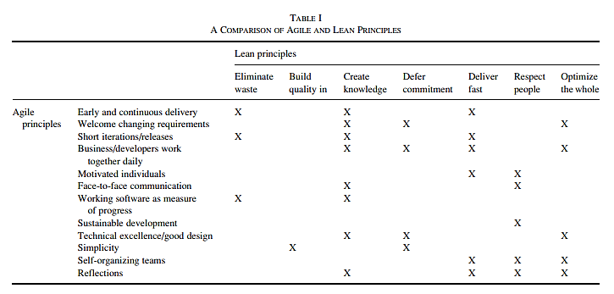

Slide 25

Fifth Week Summary
Here is what we learned

Slide 26

Thank You!

